Slide 1
Disclaimer
These slides are intended as presentation aids for the lecture. They contain information that would otherwise be to difficult or time-consuming to reproduce on the board. But they are incomplete, not self-explanatory, and are not always used in the order they appear in this presentation. As a result, these slides should not be used as a script for this course. I recommend you take notes during class, maybe on the slides themselves. It has been shown that taking notes improves learning success.

Slide 2
Reading for this set of slides
Craig – Intro to Robotics (3rd Edition)
1 Introduction
2 Spatial descriptions and transformations (2.1 – 2.9)
3 Manipulator kinematics (3.1 – 3.6)
7 Trajectory generation
Please note that this set of slides is intended as support for the lecture, not as a
stand-alone script. If you want to study for this course, please use these slides
in conjunction with the indicated chapters in the text books. The textbooks are
available online or in the TUB library (many copies that can be checked out for the entire semester. There are also some aspects of the lectures that will not be
covered in the text books but can still be part of the homework or exam. For those
It is important that you attend class or ask somebody about what was covered in class.

Slide 3
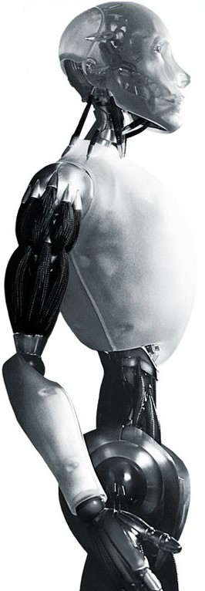
Robotics Lyapunov Stability
TU Berlin
Oliver Brock
TexPoint fonts used in EMF.
Read the TexPoint manual before you delete this box.: AAAAAAAAAAAAA

Slide 4
Stability Analysis
In a linear system stability requires k_{v} > 0
Assuming bounded disturbance we can make certain guarantees
Analysis more complex in nonlinear systems
Linearization is not always possible
inaccurate models
unknown models

Slide 5


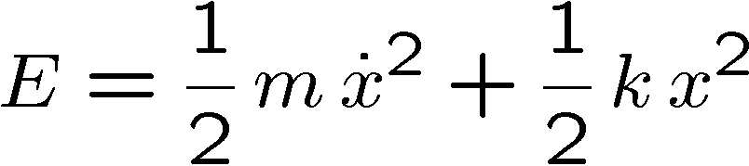
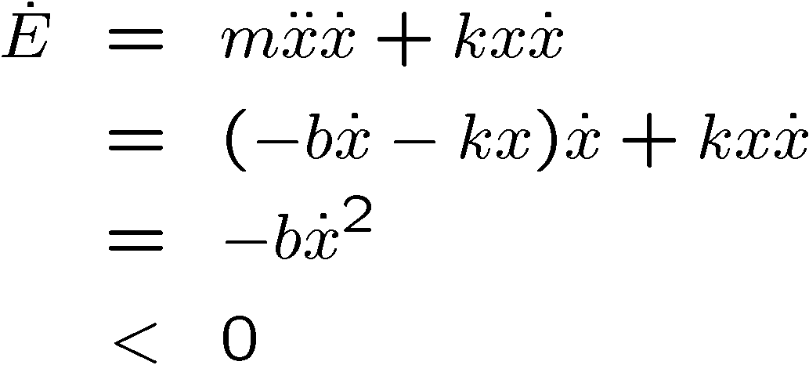
Energy-Based Stability Analysis
Energy of system is reduced until it comes to rest at x = 0

Slide 6
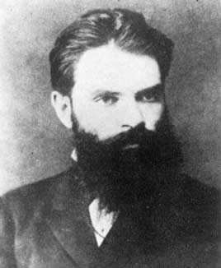
Lyapunov Stability Theory
Energy based example is an instance of Lyapunov method
Applies to linear and nonlinear systems
Stability analysis, but no performance analysis
Aleksandr Mikhailovich Lyapunov, (1857-1918), friend of Markov and Chebychev
Notes:
http://en.wikipedia.org/wiki/Lyapunov_stability

Slide 7





Lyapunov’s Second Method
Also called “direct” method
Determines stability of differential equation
Requires energy function
with continuous first partial derivatives
except for
and such that
Energy-like function that always decreases

Slide 8



Phase Plot: Lyapunov Stable
phase plot for

Slide 9
Phase Plot: Asymptotically Stable

Slide 10
Phase Plot: Unstable

Slide 11
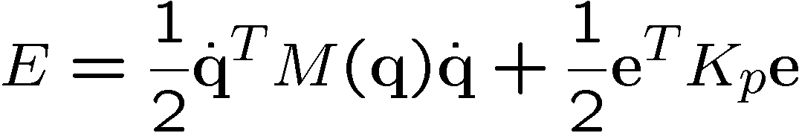
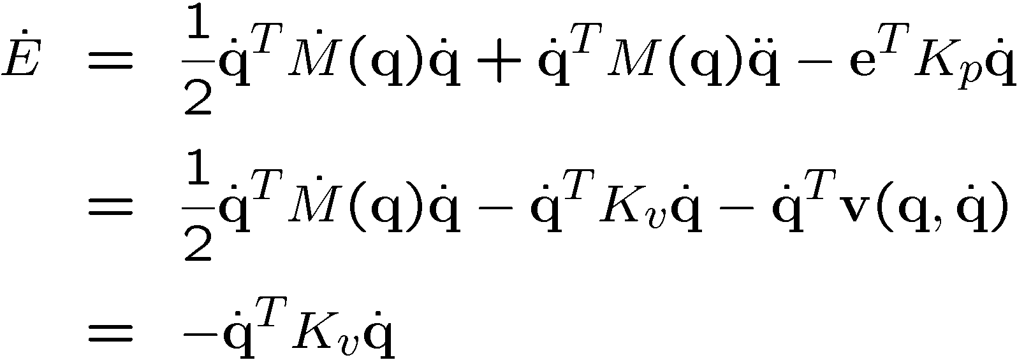
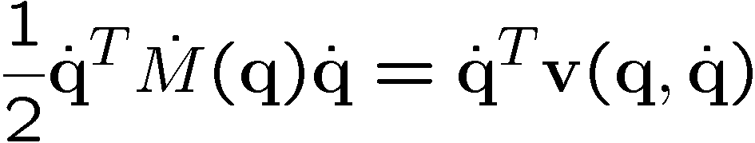
Stability of Computed Torque
Energy function:
always positive because M, K_{p} positive definite
always non-positive for K_{v} positive definite

Slide 12
Asymptotic Stability?
YES!

Slide 13
Lyapunov’s “First” Method
Called indirect method of Lyapunov
Uses linearization for nonlinear systems
Stability of local linearization determines stability of original nonlinear equations
We won’t look at it here…

Slide 14

Notes:
Background image
https://www.pexels.com/photo/background-black-blackboard-board-159770/

